Slide 1

Python programming class 2
Abaddon Tsoi

Slide 2
Variable(變數)
儲存數據的容器（Container）
必須要賦值(Assign value)
不能以keyword作變數名稱
變數名稱只能以英文字母作起始
不能在變數名稱裏使用符號（symbols），除 “_”外
Case-sensitive

Slide 3
Data types（數據類型）
Built-in vs class type
Text: str
Numeric: int, float, complex
Sequence: list, tuple, range
Mapping: dict
Set: set, frozenset
Boolean: bool
Binary: bytes, bytearray, memoryview
None: NoneType

Slide 4
Operators（運算子）
Arithmetic operators
Assignment operators
Comparison operators
Logical operators
Identity operators
Membership operators
Bitwise operators

Slide 5
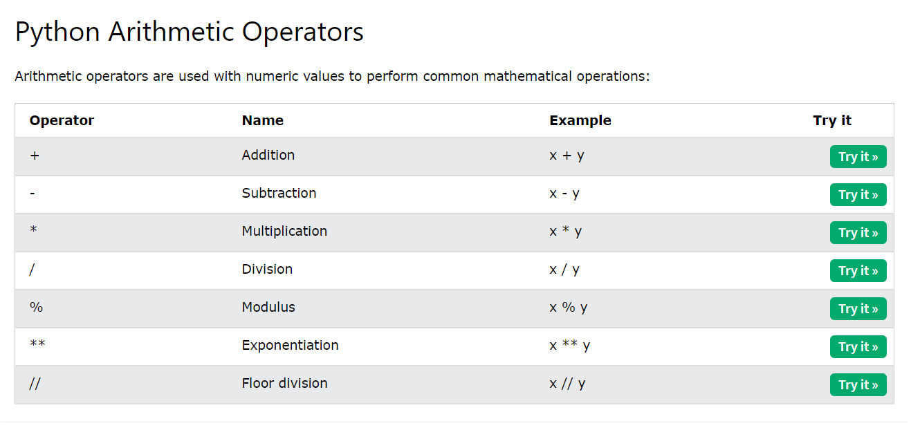

Slide 6
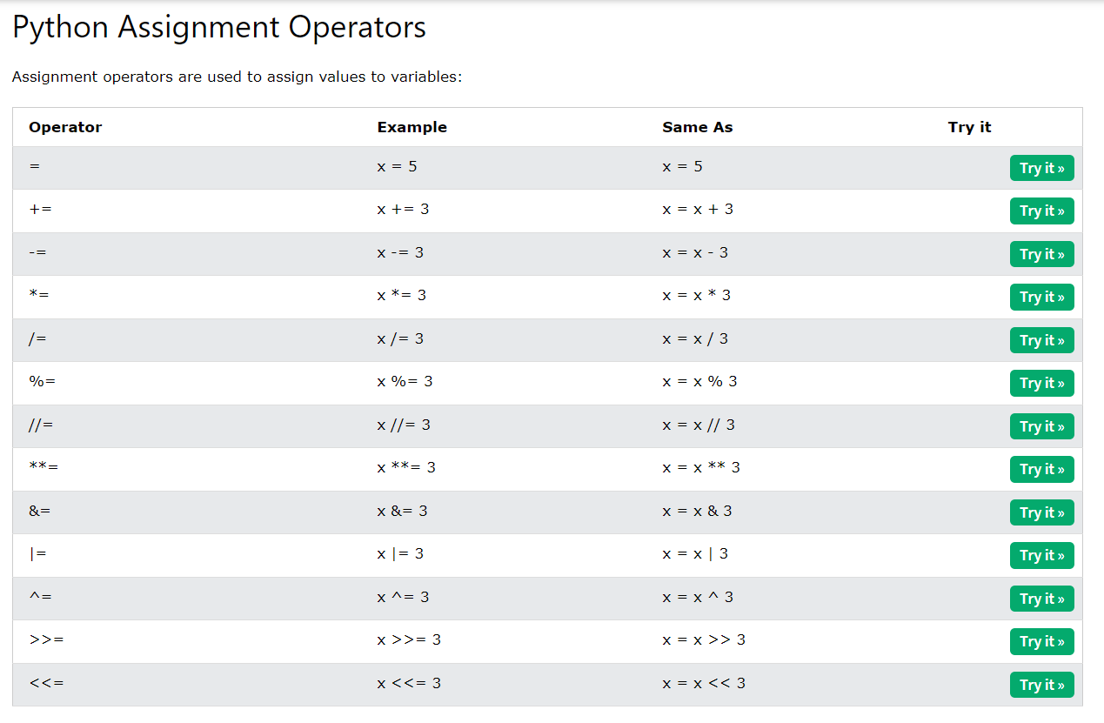

Slide 7
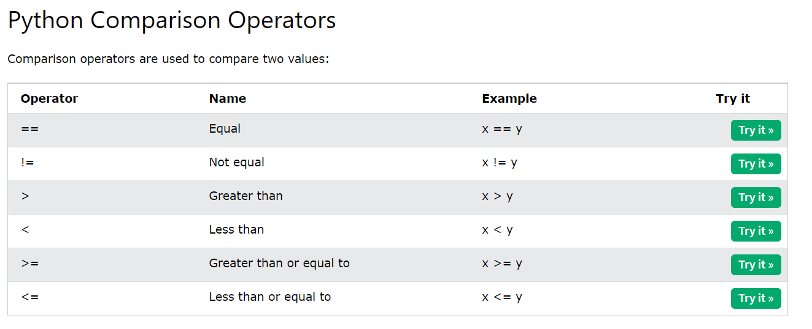

Slide 8
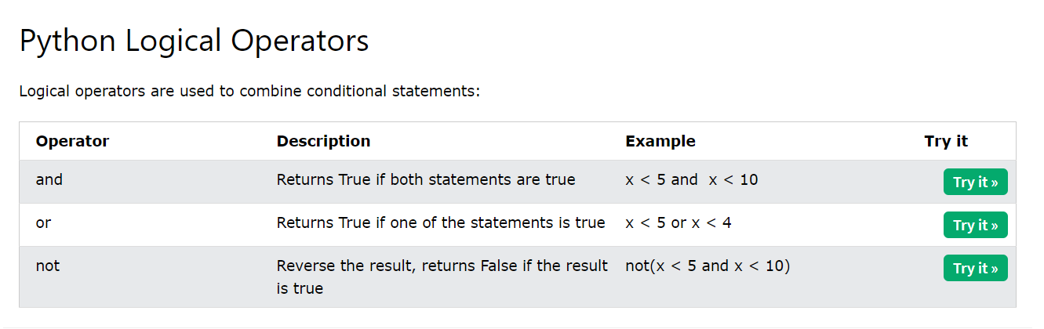

Slide 9
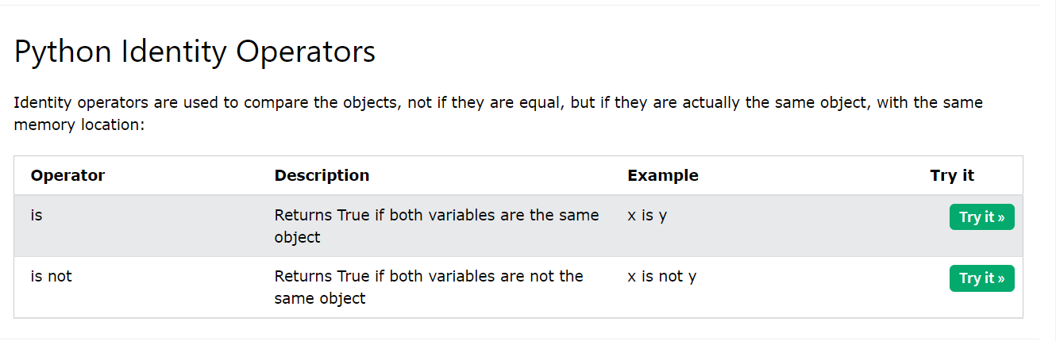

Slide 10
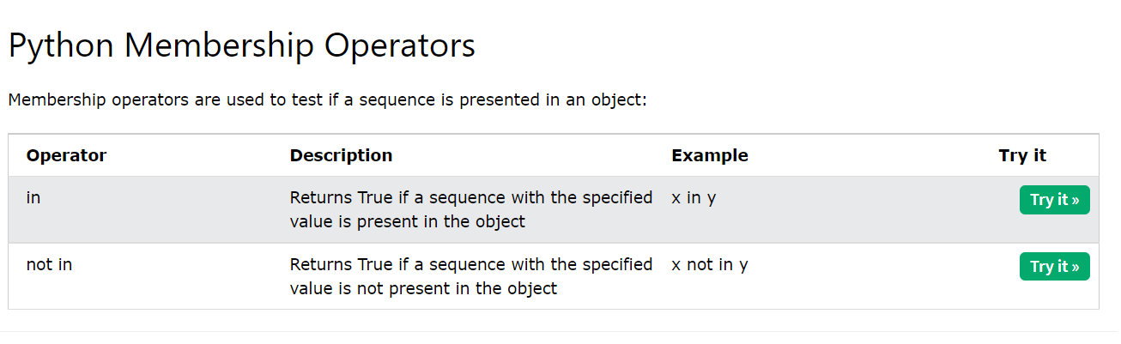

Slide 11
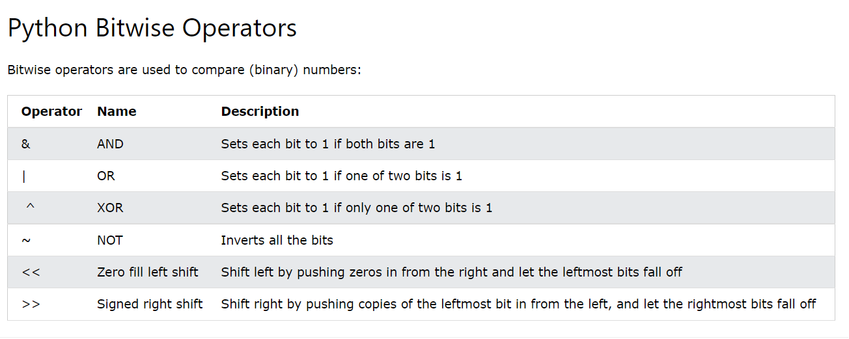

Slide 12
Appendix
Operators: https://www.w3schools.com/python/python_operators.asp

